Slide 1
Integer programming
Tuomas Sandholm
Optional reading:
Optimal Winner Determination Algorithms.
Sandholm, T. 2006.
Chapter 14 of the book Combinatorial Auctions,
Cramton, Shoham, and Steinberg, editors, MIT Press.

Slide 2
Example application: Winner determination in multi-item auctions
Auctioning multiple distinguishable items when bidders have preferences over combinations of items: complementarity & substitutability
Example applications
Allocation of transportation tasks
Allocation of bandwidth
Dynamically in computer networks
Statically e.g. by FCC
Sourcing
Electricity markets
Securities markets
Liquidation
Reinsurance markets
Retail ecommerce: collectibles, flights-hotels-event tickets
Resource & task allocation in operating systems & mobile agent platforms

Slide 3
Auction design for multi-item settings
Sequential auctions
How should rational agents bid (in equilibrium)?
Full vs. partial vs. no lookahead
Would need normative deliberation control methods
Inefficiencies can result from future uncertainties
Parallel auctions
Inefficiencies can still result from future uncertainties
Postponing & minimum participation requirements
Unclear what equilibrium strategies would be
Methods to tackle the inefficiencies
Backtracking via reauctioning (e.g. FCC [McAfee&McMillan96])
Backtracking via leveled commitment contracts [Sandholm&Lesser95,AAAI-96, GEB-01] [Sandholm96] [Andersson&Sandholm98a,b]
Breach before allocation
Breach after allocation

Slide 4
Auction design for multi-item settings…
Combinatorial auctions [Rassenti,Smith&Bulfin82]...
Bids can be submitted on combinations (bundles) of items
Bidder’s perspective
Avoids the need for lookahead
(Potentially 2^{#items} valuation calculations)
Auctioneer’s perspective:
Automated optimal bundling of items
Winner determination problem:
Label bids as winning or losing so as to maximize sum of bid prices (= revenue ≈ social welfare)
Each item can be allocated to at most one bid
Exhaustive enumeration is 2^{#bids}

Slide 5
First generation search algorithms: branch-on-items formulation [Sandholm ICE-98, IJCAI-99, AIJ-02]
Bids:
1
2
1,2
1,3,5
1,4
1
3
4
5
3,5
3
2
2,5
2
2,5
2
1,2
1,3,5
1,4
4
4
4
3
3,5
3
3
3,5
3
2,5
3,5
5
5
4
4
4
Prop. Need only consider children that include item with smallest index among items not on the path
Insert dummy bid for price 0 for each single item that has no bids
=> allows bid combinations that do not cover all items (seller can keep some items)
Generates each allocation of positive value once, others not generated
Complexity
Prop. #leaves ≤ (#bids/#items)^{#items}
Proof. Let n_{i} be the number of bids that include item i but no items with smaller index. #leaves ≤ max n₁ ∙ n₂ ∙ … ∙ n_{m} s.t. n₁ + n₂ + …+ n_{m} = #bids. Max achieved at n_{i} = n/m. Depth at most m. QED
#nodes ≤ #items #leaves
IDA* is 2 orders of magnitude faster than depth first search
Anytime algorithm
5

Slide 6
2nd generation algorithm: Combinatorial Auction, Branch On Bids [Sandholm&Suri AAAI-00, AIJ-03]
Bids of this example
A={1,2}
B={2,3}
C={3}
D={1,3}
A
B
A
D
Bid graph
C
IN
OUT
C
B
B
C
D
C
IN
OUT
IN
OUT
C
D
C
Finds an optimal solution
Naïve analysis: 2^{#bids} leaves
Thrm. At most leaves
where k is the minimum #items per bid
provably polynomial in bids even in worst case!
IN
OUT
D
D
IN
OUT

Slide 7
Integer program (IP)
max c^{t}x
subject to Ax ≤ b
x ≥ 0, and integer
Example:
z*: = max z = 5x₁ + 8x₂
s.t.
x₁ + x₂ ≤ 6
5x₁ + 9x₂ ≤ 45
x₁, x₂ ≥ 0, and integer

Slide 8
Why study integer programming in an AI course?
Integer programming and search are closely related. There is great benefit from knowing ideas from both so one can cross-fertilize across the two (in both directions)
Integer programming is the leading tool in a myriad of AI applications, e.g.:
Probabilistic inference
Optimal clustering
Combinatorial auction winner determination
Kidney exchange
Traveling salesperson problem
Supervised learning

Slide 9
IPs typically solved using tree search
A branching decision can be thought of as adding a constraint to the integer program
In a binary integer program, branching is setting a variable to 0 or 1
If the integer variable is not binary, then don’t have to necessarily branch to assign a specific value (e.g., x_{i} = 3), but, e.g., x_{i} ≥ 7
The latter can be used to have similar numbers of values on both branches, and thus similar tree sizes under both branches. (Why is this desirable?)

Slide 10
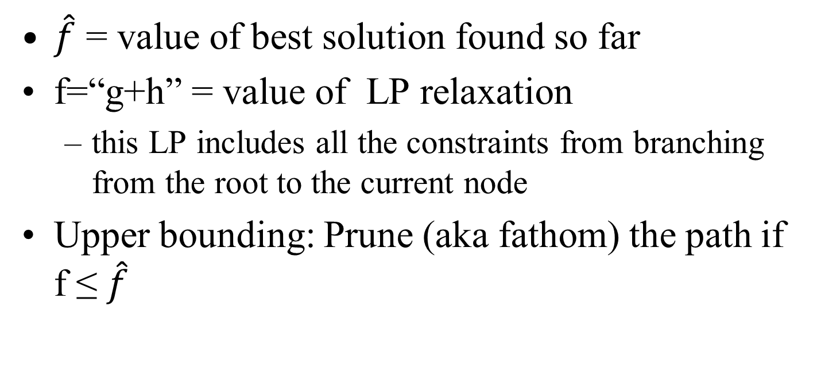
Branch and bound
$\hat{f}$ = value of best solution found so far
f=“g+h” = value of LP relaxation
this LP includes all the constraints from branching from the root to the current node
Upper bounding: Prune (aka fathom) the path if f ≤ $\hat{f}$

Slide 11
Cutting planes (aka cuts)
Extra linear constraints can be added to the LP to reduce the LP polytope and thus give tighter bounds (less optimistic f-values) if the constraints are guaranteed to not exclude any integer solutions => smaller search tree
Application-specific vs. general-purpose cuts
Branch-and-cut algorithm = branch-and-bound algorithm that uses cuts
A global cut is valid throughout the search tree (in what follows, we’ll only consider these)
A local cut is guaranteed to be valid only in the subtree below the node at which it was generated (and thus needs to be removed from consideration when not in that subtree)

Slide 12
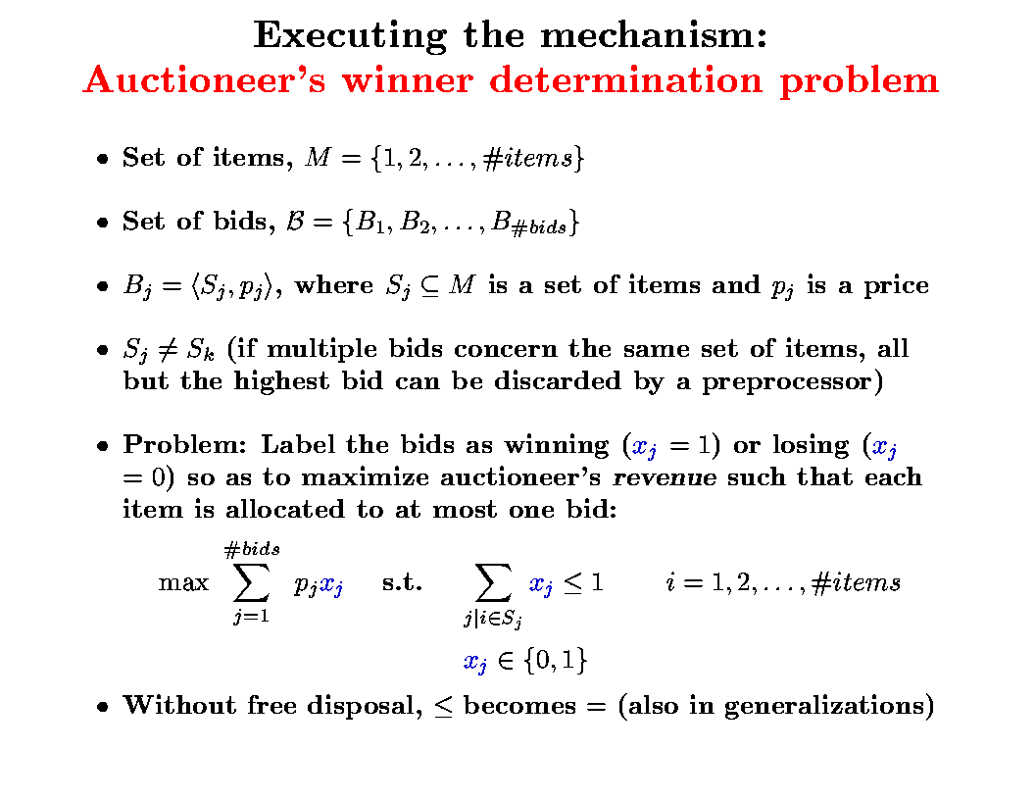
Example:
Combinatorial auction winner determination problem
Notes:
The constraint is in aggregate form here.

Slide 13
Example of a cut that is valid for winner determination: Odd hole inequality
An edge in this constraint graph means that bids share items, so both bids cannot be accepted.
x₈
x₃
x₂
E.g., 5-hole
No chord
x₁
x₆
x₁ + x₂ + x₃ + x₆ + x₈ ≤ 2
Notes:
If there is a chord, this cut is still valid, but it does not cut the LP polytope at all.
Here, the constraints have been converted into binary constraints (from the aggregated form on the previous slide).

Slide 14
Separation using cuts
LP optimum
Valid cut that separates
Valid cut that does not separate
Invalid cut

Slide 15
How to find cuts that separate?
For some cut families (and/or some problems), there are polynomial-time algorithms for finding a separating cut
Or, use:
Generate a cut
Generation preferably biased towards cuts that are likely to separate
Test whether it separates

Slide 16

Gomory cut
Applicable to all problems where objective and constraints are linear
Valid
Cut is generated automatically using the LP optimum so that the cut separates
Very fast to generate (low-order polynomial time)
Powerful for many problems

Slide 17
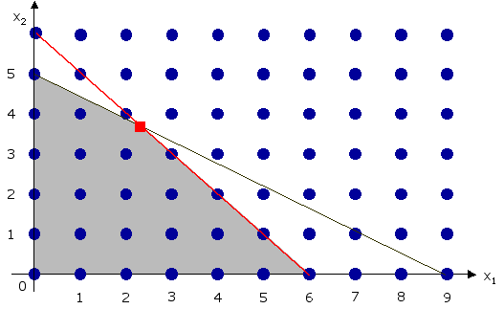
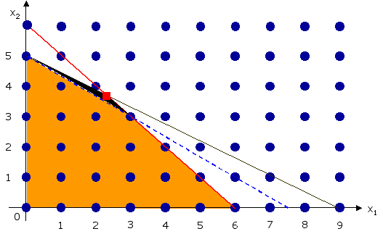
How to generate Gomory cuts? [Example from http://www.ms.unimelb.edu.au/~moshe@unimelb/620-362/gomory/]
z*: = max z = 5x₁ + 8x₂
s.t.
x₁ + x₂ ≤ 6
5x₁ + 9x₂ ≤ 45
x₁, x₂ ≥ 0, and integer
z*: = max z = 5x₁ + 8x₂
s.t.
x₁ + x₂ + s₁ = 6 5x₁ + 9x₂ + s₂ = 45 x₁, x₂, s₁, s₂ ≥ 0, and integer
}
Assume coefficients and right hand sides are integers. (Can convert into this form if they are originally rational.)
Introduce
slack variables
Optimal LP solution is x=(2.25,3.75) and the final Simplex Tableau is:
BV | x1 | x2 | s1 | s2 | RHS
x1 | 1 | 0 | 2.25 | -0.25 | 2.25
x2 | 0 | 1 | -1.25 | 0.25 | 3.75
z | 0 | 0 | 1.25 | 0.75 | 41.25
Second row in Simplex Tableau represents the constraint
0x₁ + x₂ - 1.25s₁ + 0.25s₂ = 3.75
This constraint generates the following Gomory cut:
0.75s₁ + 0.25s₂ ≥ 0.75
General process for generating a Gomory cut from a row:
Express each of the coefficients of the constraint as the sum of an integer and a non-negative fraction
Drop all the integer terms and change the = to ≥

Slide 18
Why is this valid?
Obvious Theorem. Let IL and IR be any two integers, f a positive non-integer fraction, and F the sum of nonnegative fractions such that
IL + F = IR + f
Then F ≥ f.

Slide 19
Question
If one creates (Gomory) cuts at the root, are they global or local? If one creates (Gomory) cuts at some other node of the search tree, are they global or local? [A] global; global [B] global; local [C] local; global [D] local; local

Slide 20
Advanced topics
There is a more complex Gomory cut for problems that also have real variables in addition to integer variable
There are also many other families of cuts, both general-purpose ones and problem-specific ones

Slide 21
Advanced topic: amazing! Gomory’s cutting plane algorithm
Integer program (not one that also has real variables) can be solved with no search by an algorithm that generates a finite number of these cuts. How many?
A: Potentially exponentially many
In each iteration:
Generate a cut (LP Tableau guides which cut is generated)
Include a new slack variable corresponding to that cut
Optimize the new LP (e.g., using dual simplex algorithm)
Rules against cycling in LP solving are needed to guarantee optimality in a finite number of steps
E.g., http://www.math.unl.edu/~shartke2/teaching/2008f432/Handout_Gomory.pdf
While this algorithm has been viewed as a mere curiosity, it has very recently shown promise on some practical problems (the choice of anti-cycling rule is key for speed in practice).

Slide 22
Some good variable-selection heuristics for integer programs
“Strong branching” (= 1-step lookahead)
At a node, for each variable (from a set of promising candidate variable) in turn, pretend that you branch on that variable and solve the node’s childrens’ LPs
Sometimes child LPs are not solved to optimality (cap on # of dual pivots) to save time
Pick the variable to branch on that leads to tightest child LP bounds
Sometimes better and worse child are weighted differently
“Reliability branching”
Like strong branching, but once lookahead for a certain variable has been conducted at a large enough number of nodes, stop doing lookahead for that variable, and use average reduction in bound in past lookaheads for that variable as that variable’s goodness measure
The design of good variable-selection heuristics for integer programs is largely an open research question
Goodness of a variable-selection heuristic may also depend on the node-selection rule (e.g., A* versus DFS)

Slide 23
Identifying & solving tractable cases at search nodes (so that no search is needed below such nodes)
[Sandholm & Suri AAAI-00, AIJ-03; see also Sandholm et al. Management Science 2005]

Slide 24
Example 1: “Short” bids
[Sandholm & Suri AAAI-00, AIJ-03]
Never branch on short bids with 1 or 2 items
At each search node, we solve short bids from bid graph separately
O(#short bids ³) time at the node using maximal weighted matching
[Edmonds 65; Rothkopf et al 98]
NP-complete even if only 3 items per bid allowed
Dynamically delete items included in only one bid
Can also do both short and long bids in polytime
So, the NP-hardness of the winner determination problem is caused by medium-sized bids

Slide 25
Example 2: Interval bids
At each search node, use a polynomial algorithm if remaining bid graph only contains interval bids
Ordered list of items: 1..#items
Each bid is for some interval [q, r] of these items
[Rothkopf et al. 98] presented O(#items²) DP algorithm
[Sandholm&Suri AAAI-00, AIJ-03] DP algorithm is O(#items + #bids)
Bucket sort bids in ascending order of r
opt(i) is the optimal solution using items 1..i
opt(i) = max _{b in bids whose last item is i} {p_{b} + opt(q_{b}-1), opt(i-1)}
Identifying linear ordering
Can be identified in O(|E|+|V|) time [Korte & Mohring SIAM-89]
Interval bids with wraparound can be identified in O(#bids²) time [Spinrad SODA-93] and solved in O(#items (#items + #bids)) time using our DP while DP of Rothkopf et al. is O(#items³)

Slide 26
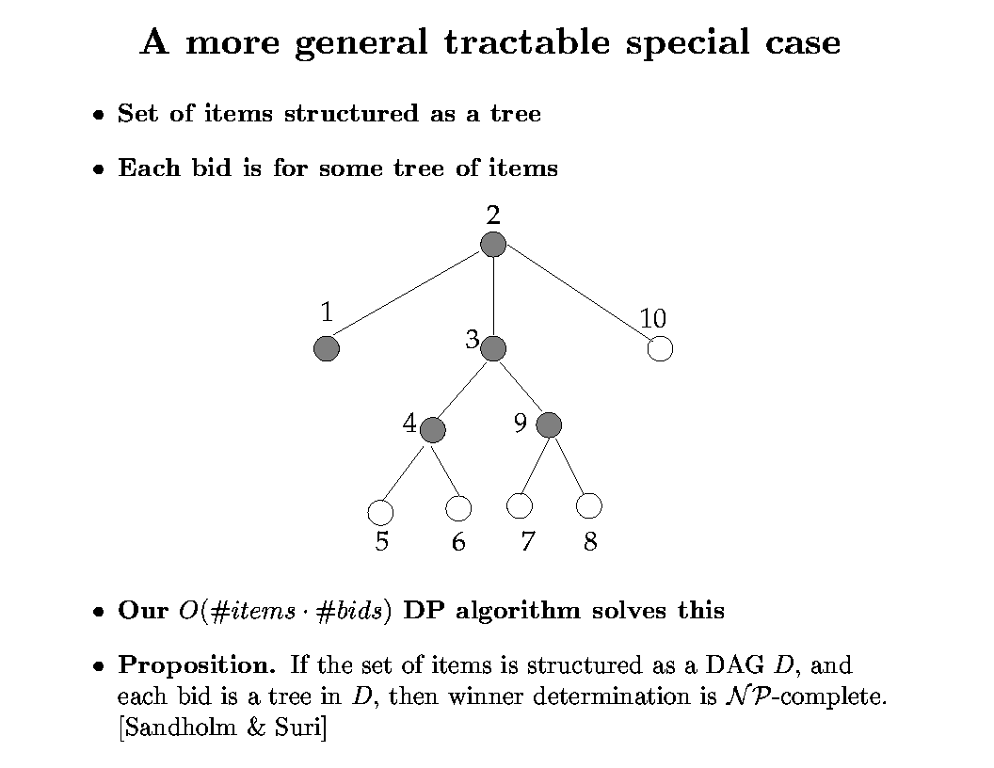
Example 3:
[Sandholm & Suri AAAI-00, AIJ-03]

Slide 27
Example 3...
Thrm. [Conitzer, Derryberry & Sandholm AAAI-04] An item tree that matches the remaining bids (if one exists) can be constructed in time O(|Bids| |#items that any one bid contains|² + |Items|²)
Algorithm:
Make a graph with the items as vertices
Each edge (i, j) gets weight #(bids with both i and j)
Construct maximum spanning tree of this graph: O(|Items|²) time
Thrm. The resulting tree will have the maximum possible weight #(occurrences of items in bids) - |Bids| iff it is a valid item tree
Complexity of constructing an item graph of treewidth 2 is unknown but it is NP-hard already for treewidth 3 [Gottlob & Greco EC-07] (but complexity of solving any such case given the item graph is “polynomial-time” - exponential only in the treewidth)

Slide 28
Example 4: Even more generality: Item graphs [Conitzer, Derryberry, Sandholm AAAI-04]
Item graph = graph with the items as vertices where every bid is on a connected set of items
Example:
Caltrain ticket
Ticket to Alcatraz, San Francisco
Ticket to Children’s Museum, San Jose
Rental car
Bus ticket
Does not make sense to bid on items in SF and SJ without transportation
Does not make sense to bid on two forms of transportation

Slide 29
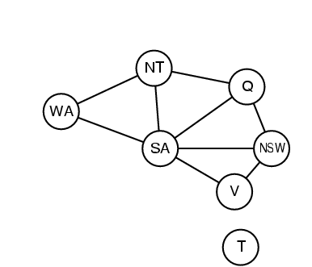
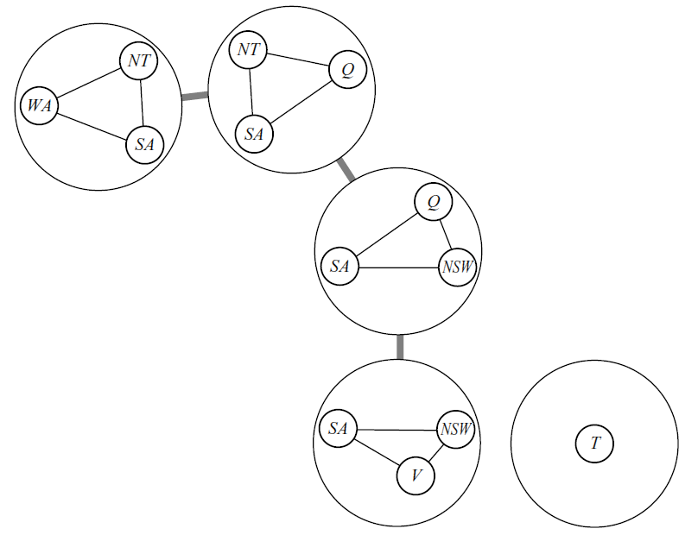
Clearing with item graphs: our old friend Tree Decomposition!
Tree decomposition of a graph G = a tree T with
Subsets of G’s vertices as T’s vertices; for every G-vertex, set of T-vertices containing it must be a nonempty connected set in T
Every neighboring pair of vertices in G occurs in some single vertex of T
Width of T = (max #G-vertices in single T-vertex)-1
Thrm. Given an item graph with tree decomposition T (width w), can clear optimally in time O(|T|² (|Bids|+1)^{w+1})
Sketch: for every partial assignment of a T-vertex’s items to bids, compute maximum possible value below that vertex (using DP)

Slide 30
Application: combinatorial renting
There are multiple resources for rent
“item” = use of a resource for a particular time slot
t₁
t₂
t₃
t₄
resource 1
…
resource 2
invalid bid
resource 3
valid bid
Assume every bid demands items in a connected interval of time periods
Green edges give valid item graph
width O(#resources)
can also allow small time gaps in bids by drawing edges that skip small numbers of periods

Slide 31
Application: conditional awarding of items
Can also sell a type of security: you will receive the resource iff state s_{i} of the world materializes
s_{i} are disjoint so that we never award resource twice
s₁
s₂
s₃
s₄
resource 1
…
resource 2
resource 3
States potentially have a linear order
e.g. s₁ = “price of oil < $40,” s₂ = “$40 < price of oil < $50,” s₃ = “$50 < price of oil < $60,” …
If each bid demands items in connected set of states, then technically same as renting setting

Slide 32
Hardness of related questions
Constructing the item graph with the fewest edges is NP-complete
Even when each bid is on at most 5 items, and an item graph of treewidth at most 2 is known to exist; regardless of whether we require the constructed tree to have treewidth 2.
What if a bid can include a few (say, k) connected sets rather than just one?
Clearing is NP-complete even when the graph is a line and k = 2
Deciding whether a line graph exists with k = 5 is NP-complete

Slide 33
Generalization: substitutability [Sandholm IJCAI-99, AIJ-02]
What if agent 1 bids
$7 for {1,2}
$4 for {1}
$5 for {2} ?
Bids joined with XOR
Allows bidders to express general preferences
Groves-Clarke pricing mechanism can be applied to make truthful bidding a dominant strategy
Worst case: Need to bid on all 2^{#items}-1 combinations
OR-of-XORs bids maintain full expressiveness & are more concise
E.g. (B₂ XOR B₃) OR (B₁ XOR B₃ XOR B₄) OR ...
Our algorithms apply (simply more edges in bid graph)
Can also be encoded using “dummy items”
Structure required for polytime special cases less frequent here
See also more natural and compact bidding languages [Sandholm, T. 2013. Very-Large-Scale Generalized Combinatorial Multi-Attribute Auctions: Lessons from Conducting $60 Billion of Sourcing. Ch.16 in The Handbook of Market Design]

Slide 34
Incremental generation of the search problem as needed
Branch-and-price
Column generation in the LP
Constraint generation

